Slide 1
Foundations of neural networks
An in-depth mathematical perspective
~ by Tarun Paparaju

Slide 2
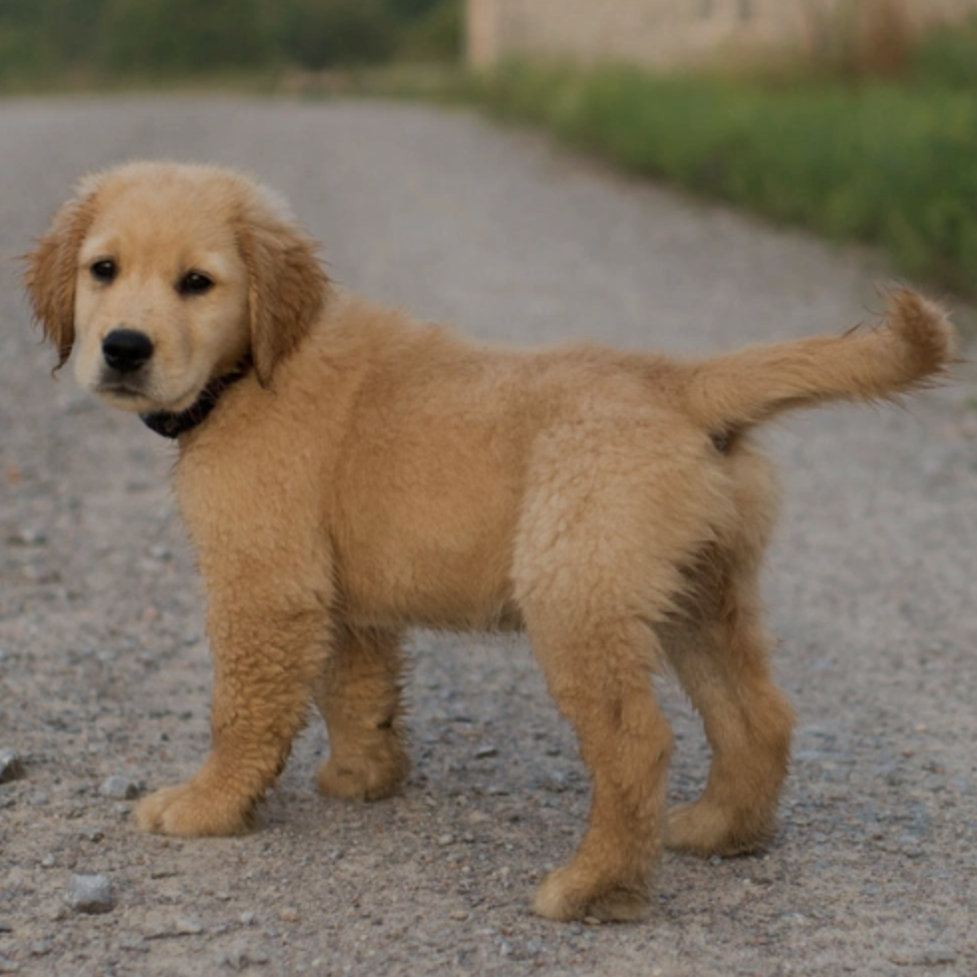
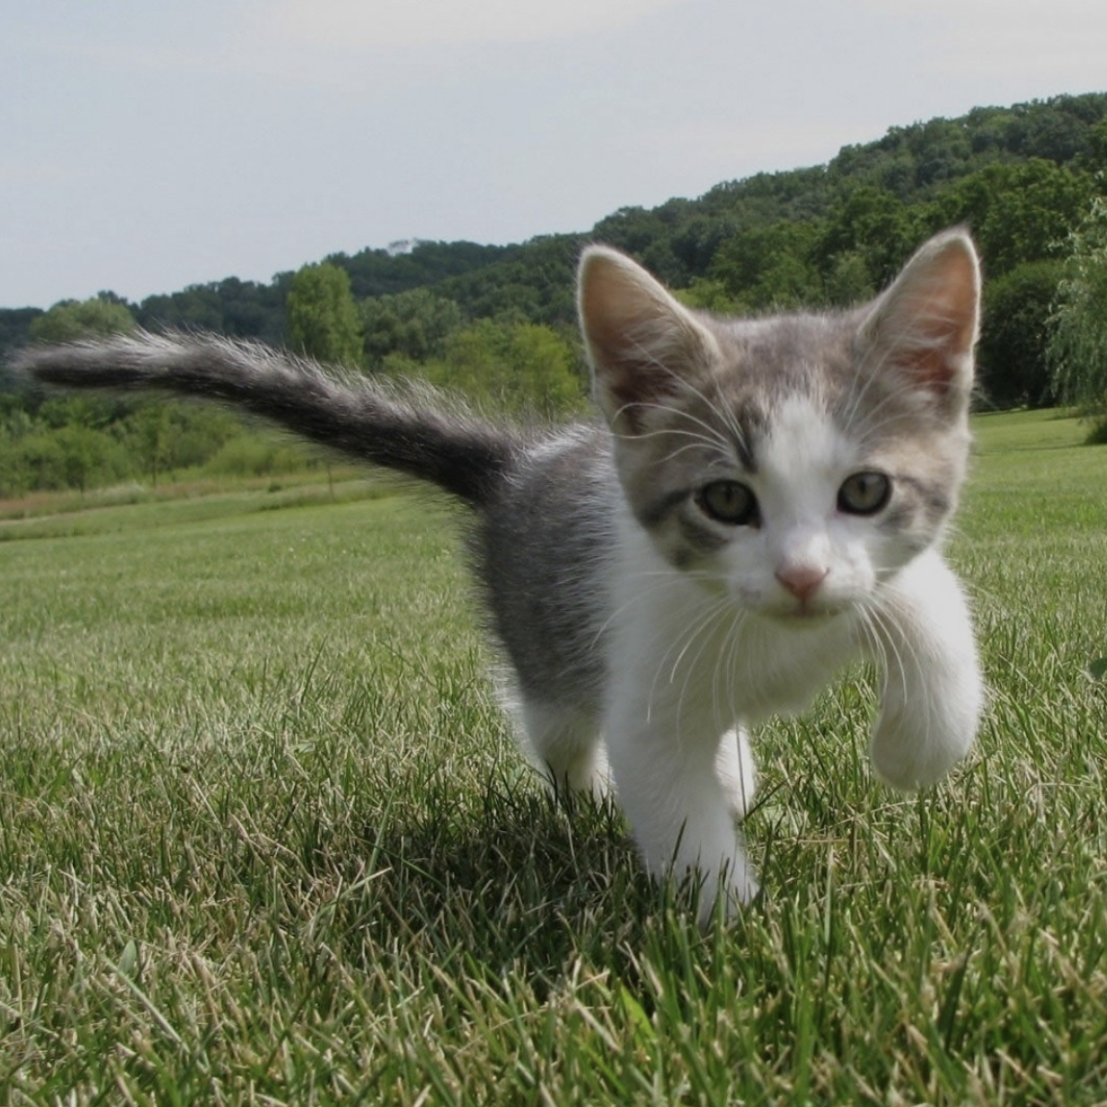
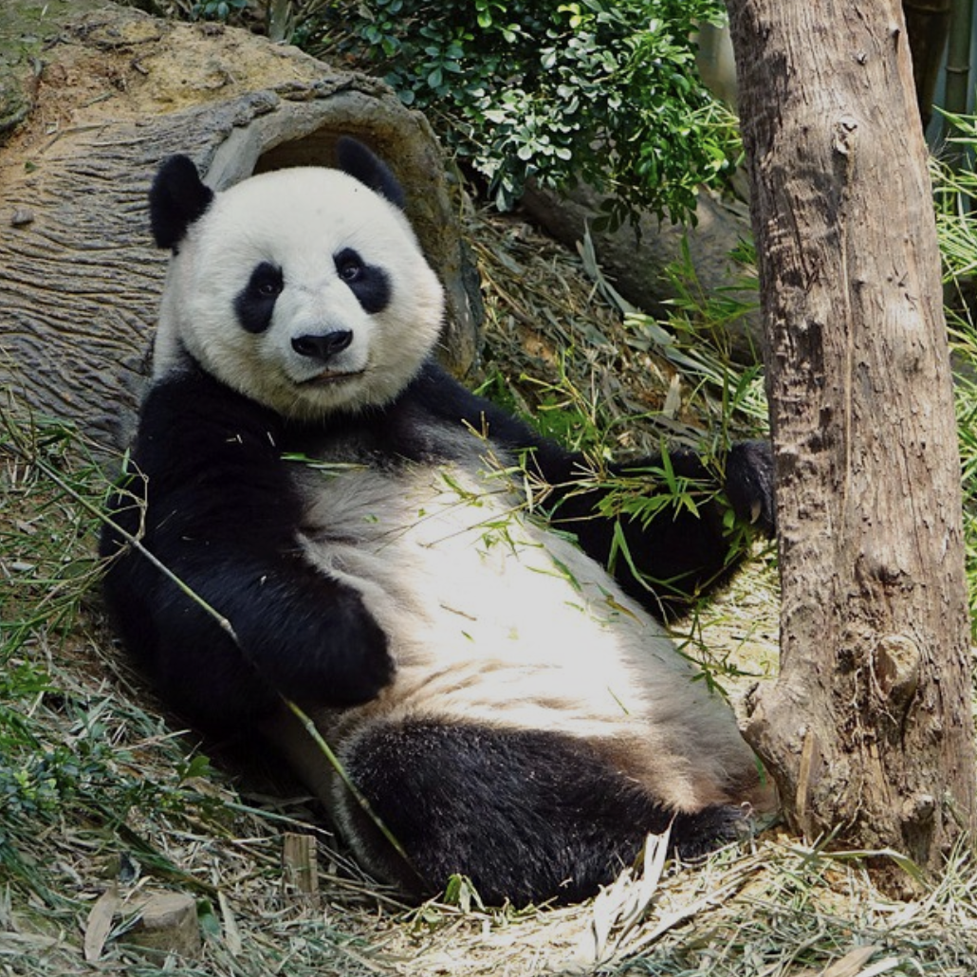
An example problem
Recognizing animals from images
How can machines recognize animals from their images?

Slide 3
Recognize animals from images
Artificial intelligence (Machine learning / Deep learning)
Enter the world of Artificial Intelligence
(a reflection of the human brain)

Slide 4
Recognize animals from images
Deep learning is based on Neural networks
Deep learning is a branch of machine learning and its core algorithm is the neural network.
Neural network structure and function is inspired by the human brain. They have multiple layers of interconnected neurons, just like the human brain.
These neural networks learn patterns and relationships from vast amount of data.

Slide 5
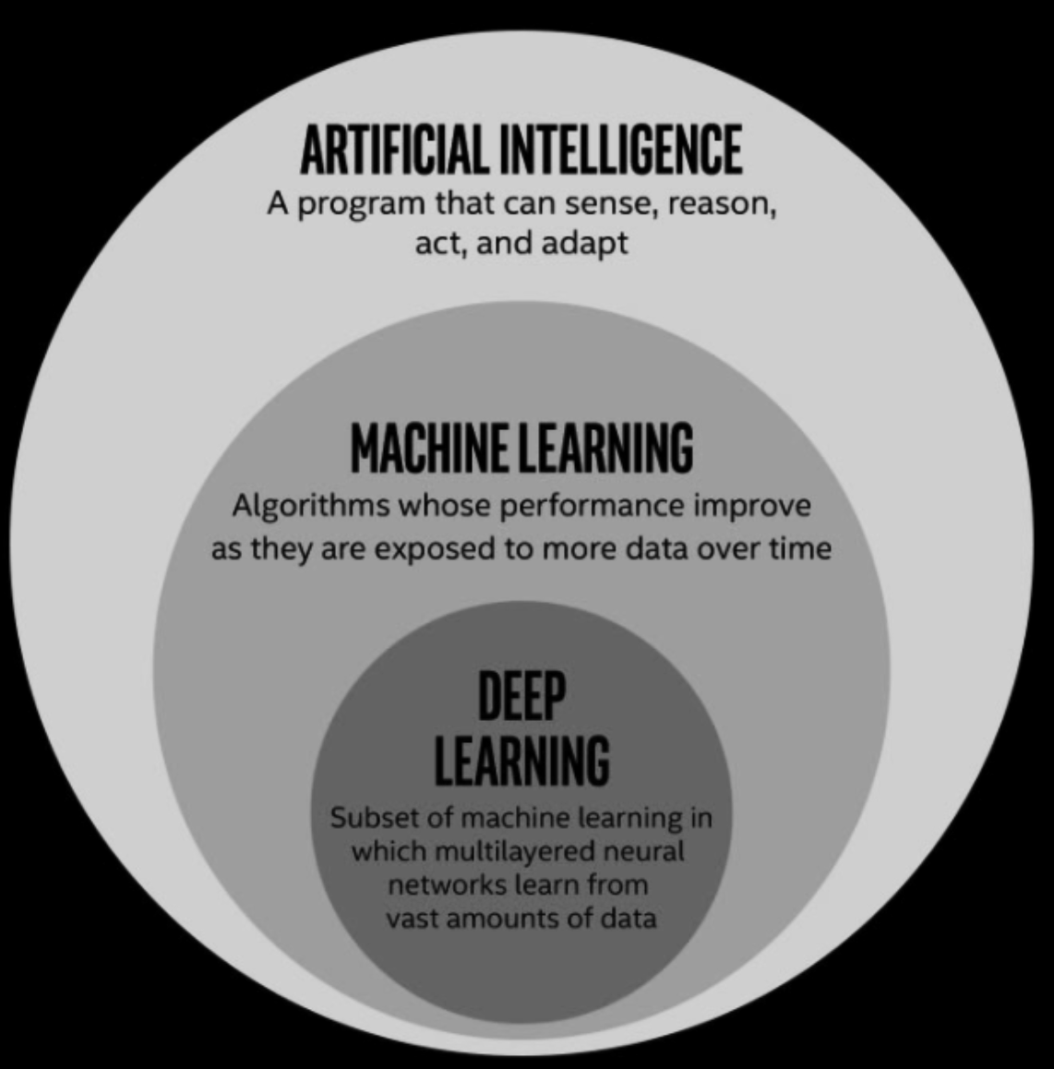
Recognize animals from images
Deep learning is based on Neural networks

Slide 6

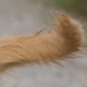

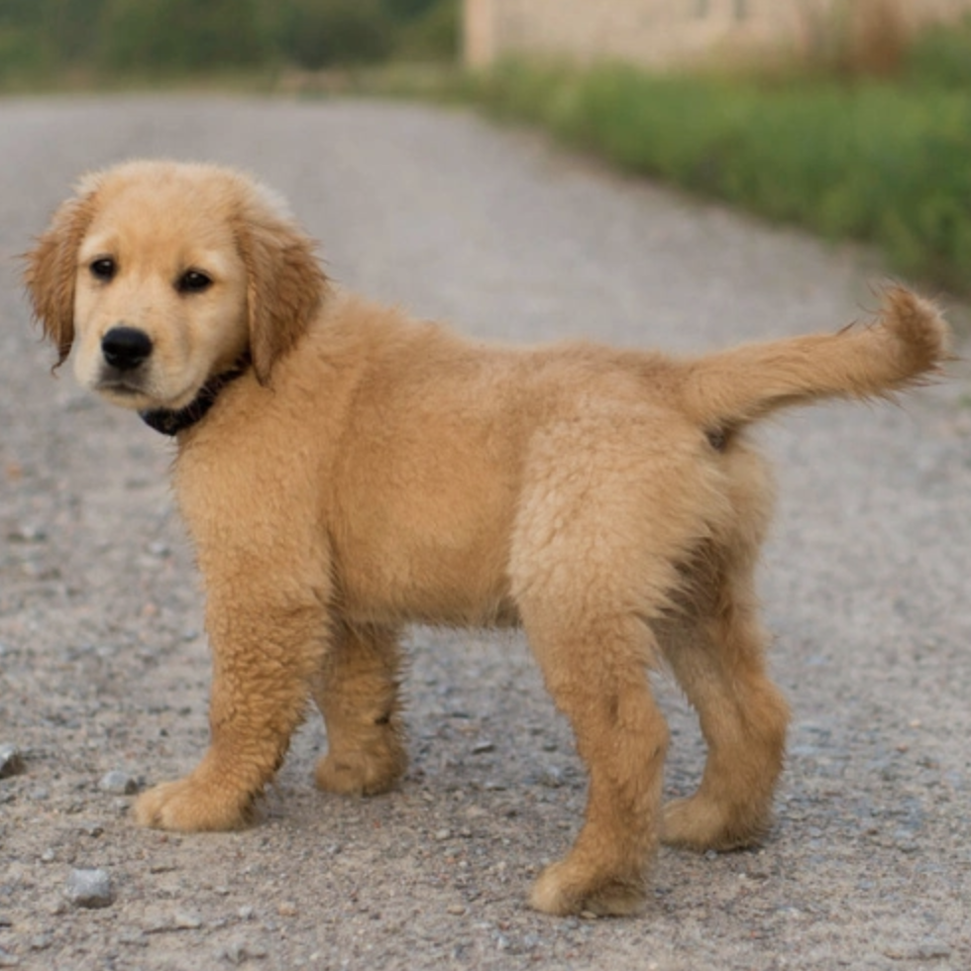
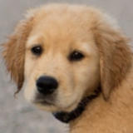
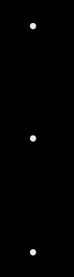
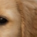
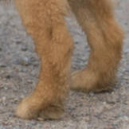
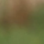
Recognize animals from images
Basics of Neural networks
The dog has been given a high score. It’s most probably a dog
Hidden Layers
Combines features hierarchically to produce more complex patterns (pixels to curves, curves to shapes, shapes to faces)
Dog
Input Layer
The input layer contains all the pixels in the image in a 784-D vector.
One batch of images is passed at a time.
Cat
Other
The cat and other animals have a very low score, so it’s probably neither of them.
Output Layer
Output layer outputs probabilities for each category.

Slide 7
Recognize animals from images
Overview
Neural network concept | Mathematical concept
Forward propagation | Matrix multiplication and Vector addition
Loss function | Distance and Similarity measures
Optimizer | Gradient-based optimization
Back propagation | Jacobian matrices, Gradient vectors and the Chain rule
Regularization | Bernoulli distribution and Distance measures

Slide 8
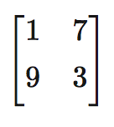
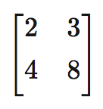
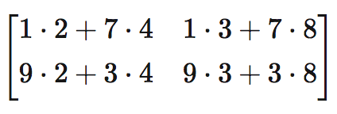

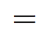
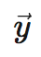

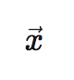
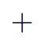
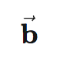
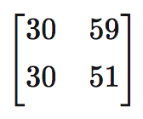


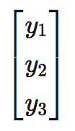
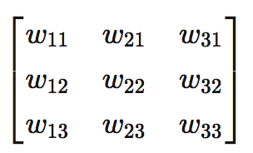
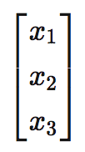
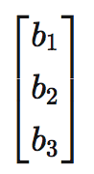
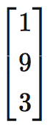
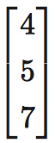
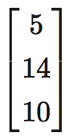
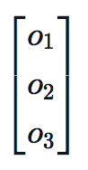
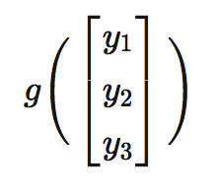
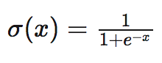
Mapping mathematics concepts to neural networks
Forward propagation
Information propagated forward through the network from input to output layer.
Neural network concept | Mathematical concept
 | Matrix multiplication
 | Non-linear functions
w₁₁
propagate through more layers
x₁
y₁
w₁₂
Output
Weights
Input
Bias
w₁₃
+ b₁
w₂₁
And so on
x₂
w₂₂
y₂
w₂₃
+ b₂
Vector addition
w₃₁
Loop back for next iteration (data batch)
x₃
w₃₂
y₃
w₃₃
+ b₃
where g is some non-linear function:
Eg. Sigmoid function (others include ReLU, TANH, etc)
Sigmoid:
Final output of 2nd layer: vector o

Slide 9
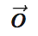
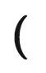
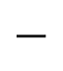
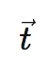
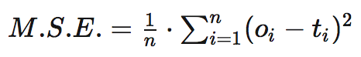
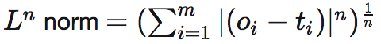
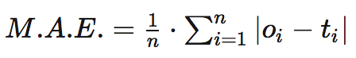
Mapping mathematics concepts to neural networks
Loss function
A function that measures how well the neural network performs on data (error measurement).
Neural network concept | Mathematical concept
Distance/Similarity measures
Let the network output vector be:
x₁
o
o - t
o₁
2
Let the expected output vector be:
t₁
The model performance is decided by the average deviation between predicted and expected values.
t
J
x₂
2
o₂
t₂
Loss functions are based on distance measures in mathematics.
Eg. T.S.E. is the squared magnitude of the difference in the o and t vectors. This is the square of the L² norm of the vector o - t.
Eg. Mean Squared Error
x₃
2
o₃
t₃
Eg. Mean Absolute Error
The Loss
function
Eg. T.A.E. is the sum of the absolute values of the o -t vector. This is the L¹ norm of the o - t vector.
Loop back to beginning for next iteration

Slide 10
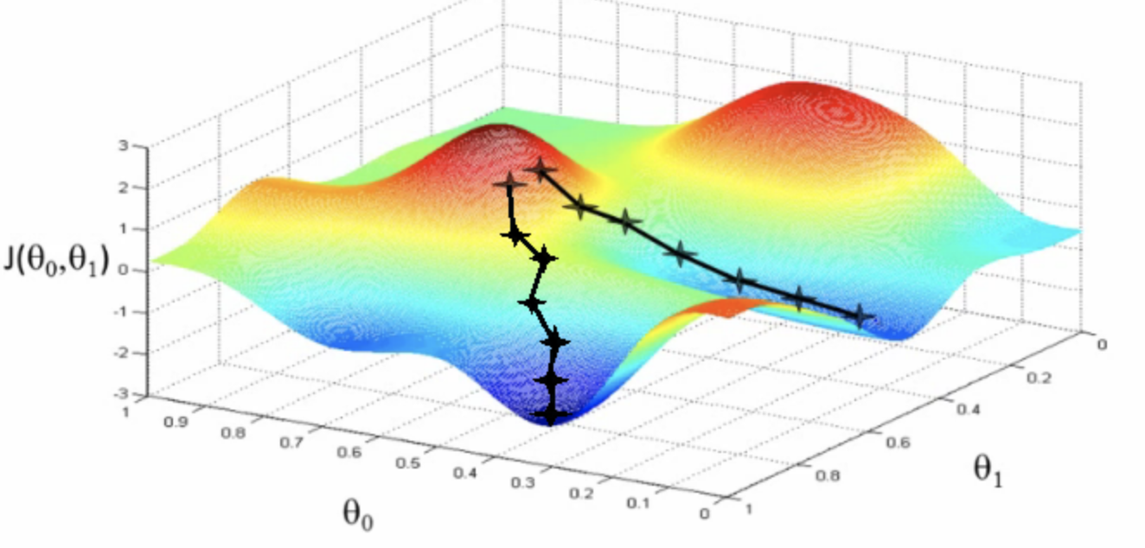
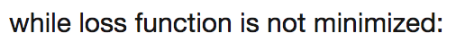
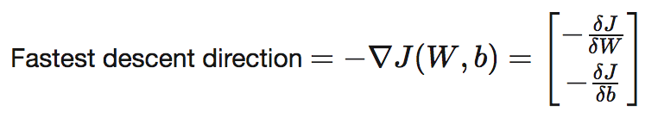
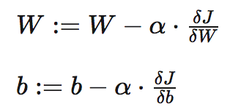
Mapping mathematics concepts to neural networks
Optimizer
An algorithm that iteratively adjusts the weights and biases of the network to reduce the loss function.
Neural network concept | Mathematical concept
Let the loss function for the neural network be:
Gradient-based optimization
w₁₁
Adjust weights
x₁
w₁₂
y₁
w₁₃
+ b₁
Let the loss function be called J(W, b). We must find the optimal values for W and b such that J(W, b) is minimized. Gradient Descent is a popular algorithm for this task:
w₂₁
x₂
y₂
w₂₂
w₂₃
+ b₂
w₃₁
w₃₂
x₃
y₃
w₃₃
Therefore:
+ b₃
We need to move the weights W and biases b in the direction of fastest descent. This direction is the negative of the gradient of the loss function with respect to W and b.
Adjust all the weights on the connections in the network, so that the output matches the expected output for a given input.
Above, α is the learning rate that decides the size of each update.

Slide 11
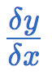
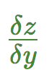
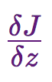
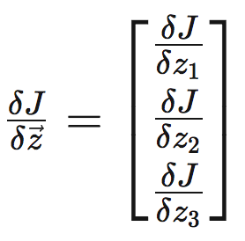
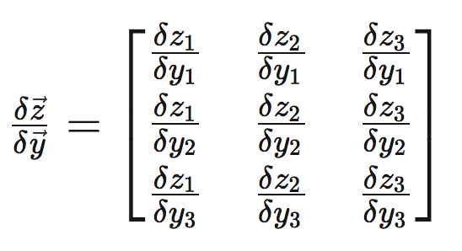
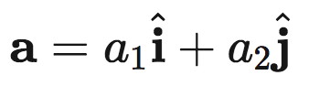
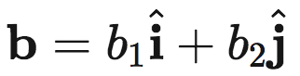
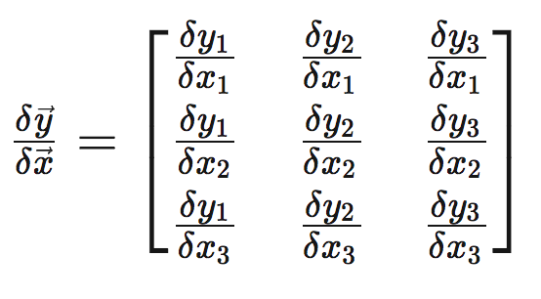
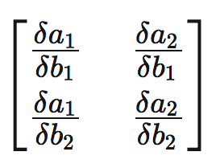





Mapping mathematics concepts to neural networks
Back propagation
A method to efficiently calculate the gradient vector required to optimize the weights and biases.
Neural network concept | Mathematical concept
 | Jacobian matrix of a with respect to b is:
x
y
z
Jacobian matrices
Assume that there is only one weight called p. Then:
x₁
Consider vectors a and b:
y₁
1)
2)
z₁
x₂
J
3)
4)
y₂
z₂
x₃
Gradient vectors
y₃
z₃
The Loss
function
The partial derivative of the loss function with respect to the parameters is the product of the above 4 matrices in order from 1 to 4 (by the Chain Rule)
Gradient vector of function f(x, y, z) is:
Let the vector of all weights and biases be p. Then, the gradient of J is as follows
Chain Rule

Slide 12
Mapping mathematics concepts to neural networks
Regularization
Methods to prevent neural networks from overfitting
Neural network concept | Mathematical concept
Overfitting is the tendency of a neural network to perform very well on the training data which it has seen, but fail to perform well on the unseen testing data. The network memorizes instead of understanding. This problem can be tackled using Dropout, a type of regularization. In Dropout, neurons in a layer are randomly selected with a given probability and ignored (set to 0). This makes sure that all the neurons work together effectively, reducing overfitting. | Bernoulli Distribution A discrete probability distribution with only two possible outcomes: to drop or not to drop a neuron. Distance measures Distance measures such as L¹ norms and L² norms are used in L1 and L2 regularization.
Dropout
w
L1 and L2 Regularization
w
L1 and L2 regularization penalizes large magnitudes for weights and biases as they indicate memorization. This is done by adding a regularization term to the cost function, the L¹ norm in L1 regularization and the squared L² norm in L2 regularization. (λ is the regularization term)
(w is worse than w)
L1 Regularization:
L2 Regularization:

Slide 13
Recognize animals from images
Summary
Neural network concept | Mathematical concept
Forward propagation | Matrix multiplication and Vector addition
Loss function | Distance and Similarity measures
Optimizer | Gradient-based optimization
Back propagation | Jacobian matrices, Gradient vectors and the Chain rule
Regularization | Bernoulli distribution and Distance measures

Slide 14
Recognize animals from images
Summary
Similar concepts can be used to build specialized architectures for language and vision problems!
NLP (RNN, LSTM, Transformers)
Text Sentiment Classification
Automated Question-Answering
Conversational scheduling chatbots
CV (CNN, Capsule)
Product anomaly detection
Lung and skin disease diagnosis
Automatic image segmentation for E-commerce

Slide 15
Any Questions?

